Slide 1

Web-based Teacher-Student Examination System with NLP-Driven Automated Scoring and Google Sheets Integration
Chavan Advait Gurunath (PRN: 250220528009)
PG Diploma in Artificial Intelligence, CDAC Noida
Date: 05 August 2025

Slide 2
Motivation & Problem Statement
Online and blended learning demands scalable, low-cost assessment tools
Manual grading of open-ended responses is time-consuming and inconsistent
Commercial platforms often incur licensing fees
Educators juggle multiple systems, causing delays and potential bias

Slide 3


Objectives & Scope
Objectives
Secure email-based login for teachers and students
Dynamic question creation stored in Google Sheets
Instant, semantically informed scoring via Flask microservice
Secure routing through proxy
Zero-cost data persistence in Google Sheets
Scope Exclusions
Multiple-choice questions
Proctoring features
Mobile-app clients

Slide 4

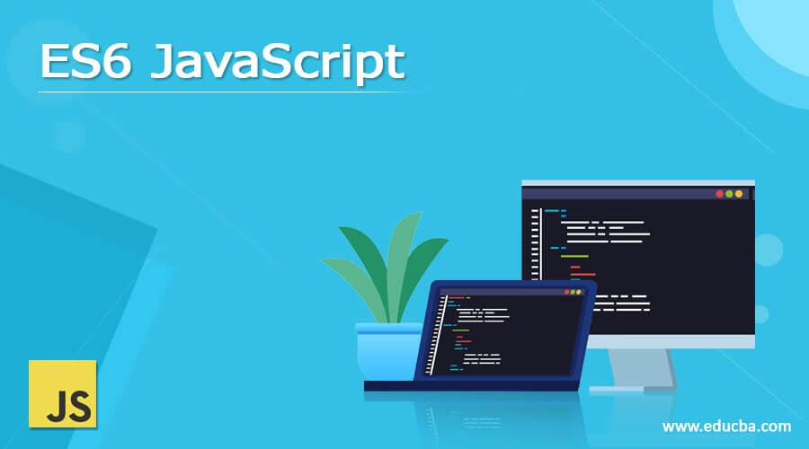


System Architecture
Front-End: HTML5, CSS3, JavaScript ES6 modules
Proxy Server: Node.js + Express for secure API routing
Backend: Google Apps Script (proxies to Google Sheets)
Scoring Service: Flask microservice with Sentence-Transformer
This Photo by Unknown Author is licensed under CC BY-SA

Slide 5
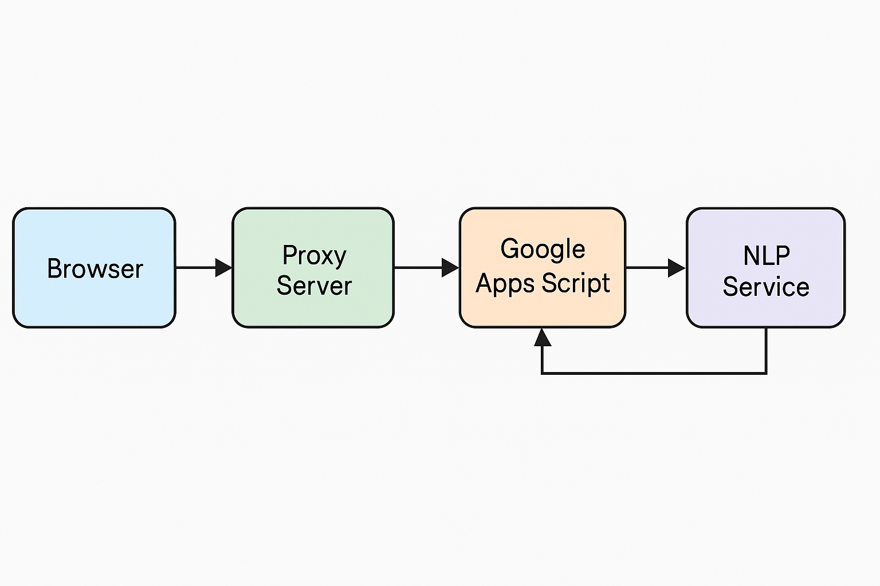
System Architecture

Slide 6
UML Diagrams
Class Diagram
class Teacher {
+login()
+postQuestions()
+viewResults()
}
class Student {
+login()
+takeExam()
+viewResults()
}
class Question {
-id: int
-text: String
-choices: List<String>
+getDetails(): Question
}
class ScoringService {
+score(responses: Map<Question,String>): int
}
Teacher "1" -- "*" Question : creates
Student "1" -- "*" Question : takes
Student --> ScoringService : uses
Teacher --> ScoringService : uses
Use case Diagram
actor Teacher
actor Student
Teacher --> (Login)
Student --> (Login)
Teacher --> (Create Questions)
Teacher --> (Fetch Questions)
Student --> (Fetch Questions)
Student --> (Submit Responses)
Teacher --> (View Results)
Student --> (View Results)

Slide 7
Implementation – Front-End & Proxy
Front-End Pages
login_teacher.html / login_student.html
teacher_dashboard.html (question creation)
student_exam.html (exam and results)
Key Files
style.css: layout and table styling
main.js: handles login, question CRUD, exam flow
Proxy
using Express and CORS
Forwards client requests to Apps Script endpoints

Slide 8
Implementation – Backend & Scoring
Google Apps Script (Code.gs)
Endpoints: teacherLogin, studentLogin, postQuestions, getQuestions, submitResponses
Reads/writes the four Sheets as JSON
Flask Scoring Service (score_api.py)
Loads all-MiniLM-L6-v2 SentenceTransformer
Computes cosine similarity between desired and student answers
Normalizes and scales scores to question marks

Slide 9
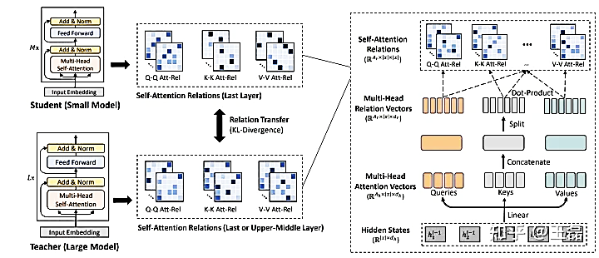
NLP Model Selection
Feature | all-MiniLM-L6-v2
Embedding Dimension | 384
Transformer Layers | 6 layers, 12 attention heads each
Model Size | <100 MB
Inference Speed | ~10,000 sentences/sec on CPU
Semantic Accuracy (STS) | Pearson > 0.75
Chosen for balance of speed, footprint, and semantic performance

Slide 10
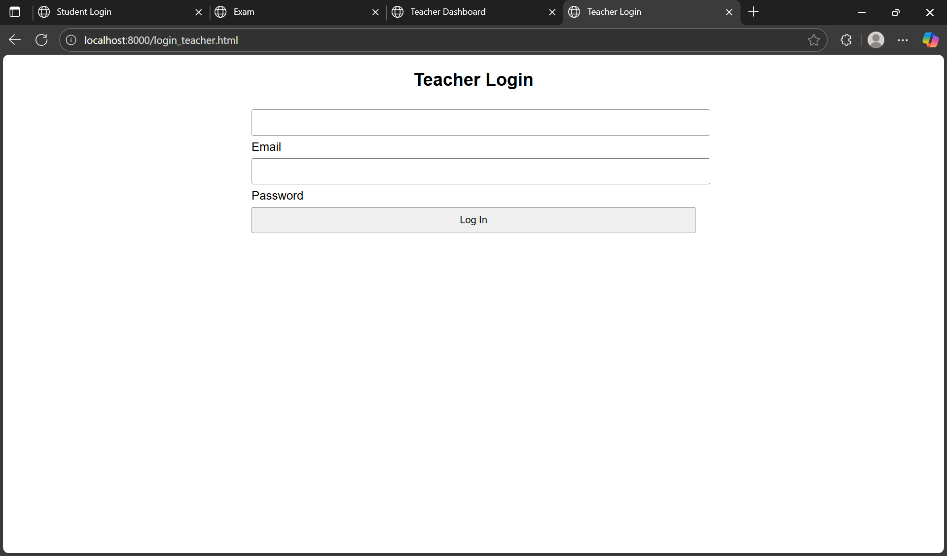
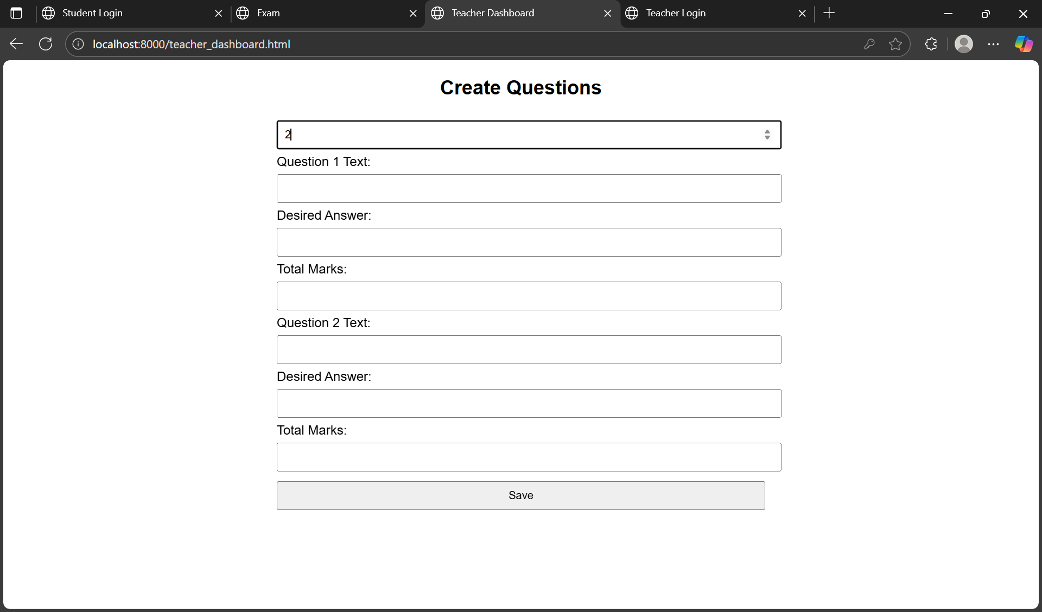
Interface Snapshots
Teacher Dashboard
Teacher Login Page
Question creation form

Slide 11
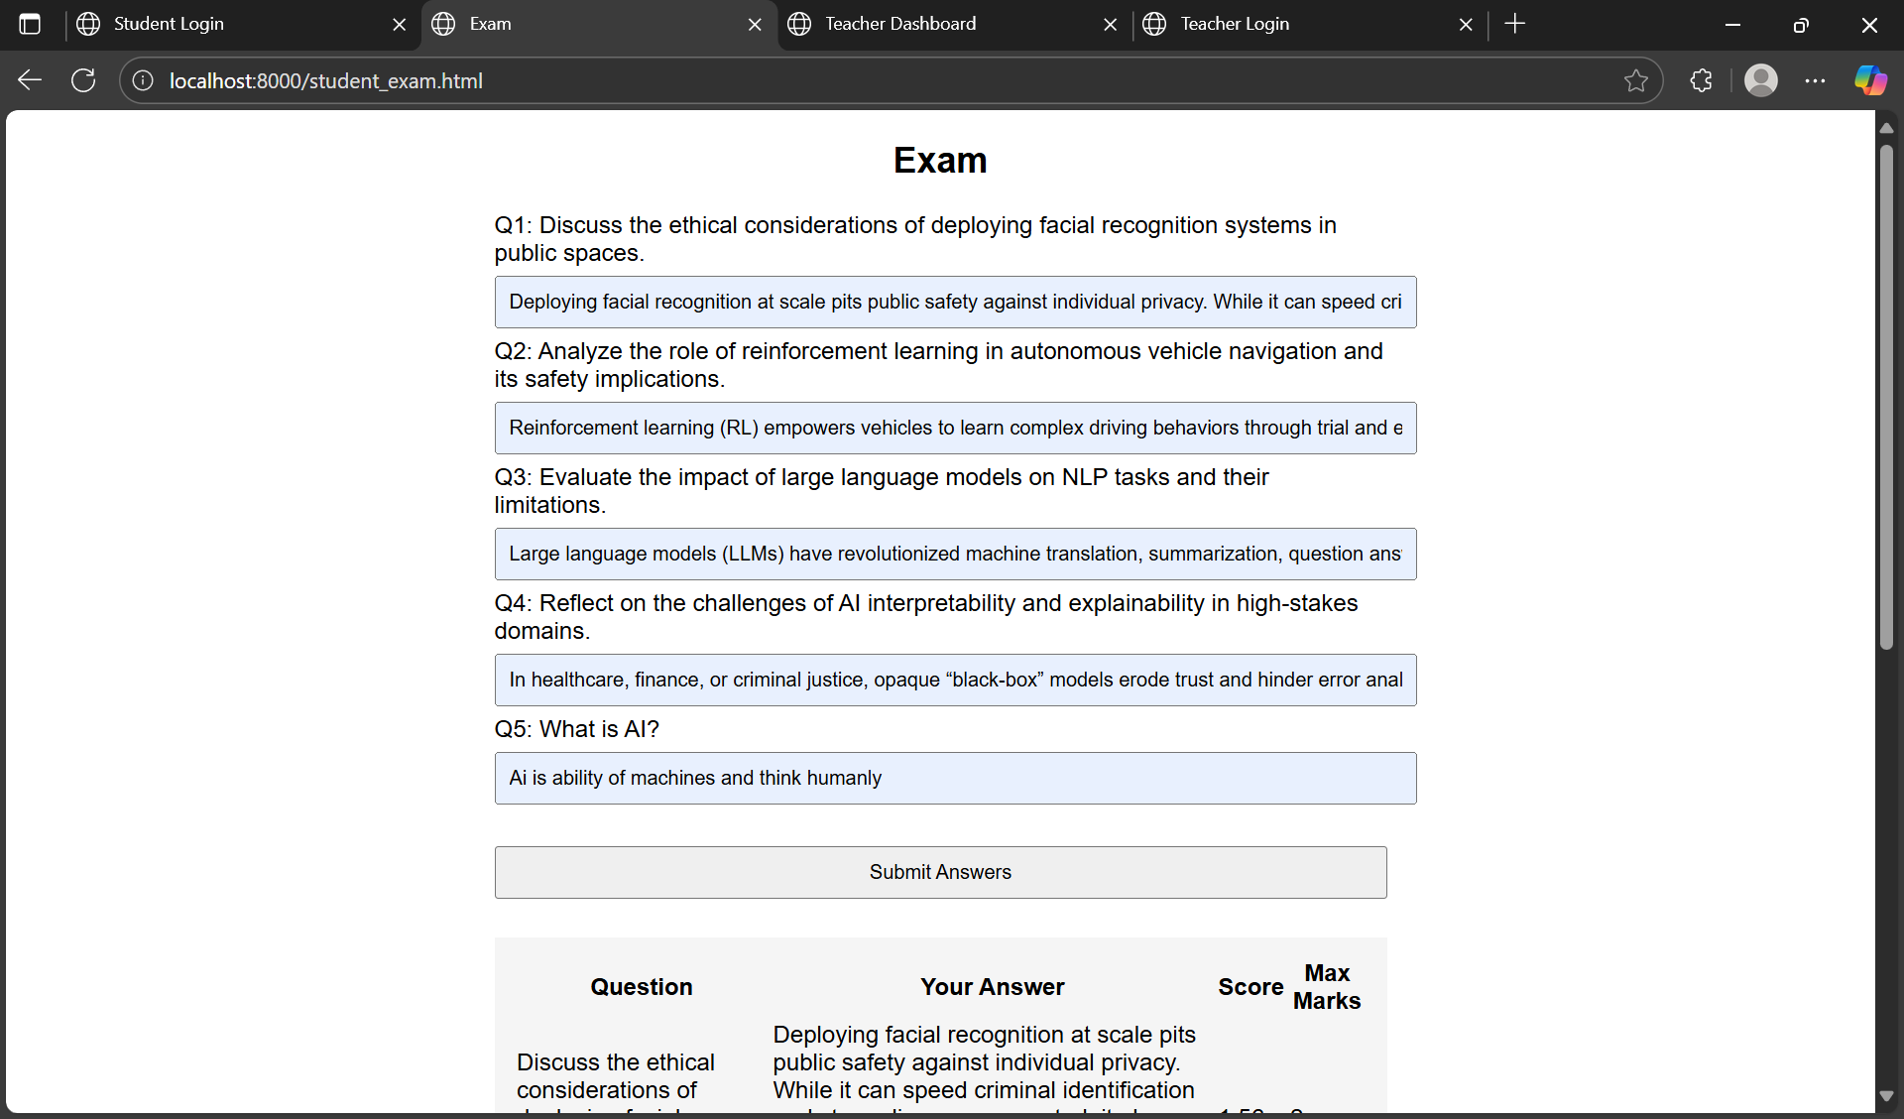
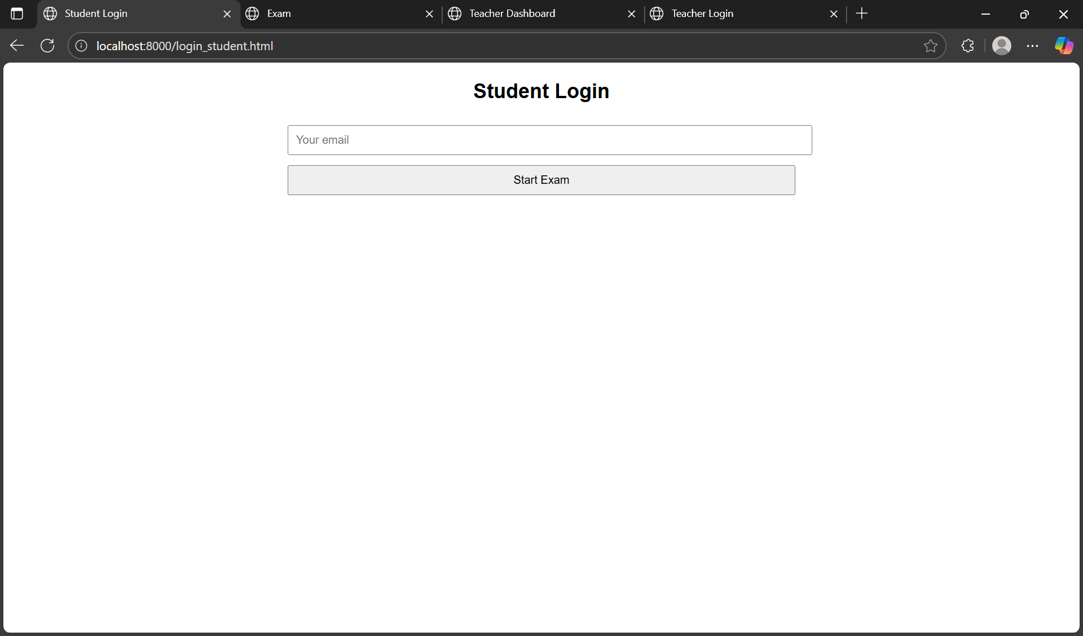
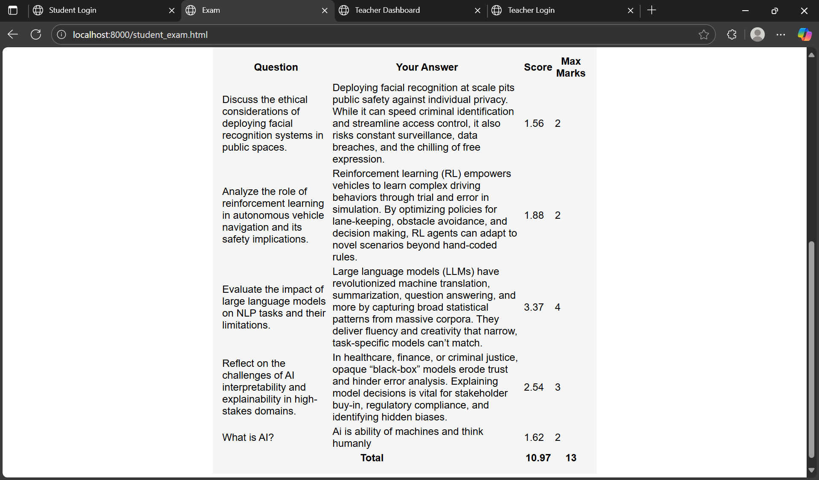
Interface Snapshots
Dynamic question display
Student Exam & Results
Student Login Page
Instant score table

Slide 12
Testing & Results
Test ID | Description | Expected Result | Status
TC01 | Valid teacher login | Redirect to dashboard | Pass
TC02 | Invalid teacher credentials | “Invalid credentials” alert | Pass
TC03 | Post questions | New rows in Questions sheet | Pass
TC04 | Unregistered student login | “Email not registered” alert | Pass
TC05 | Fetch questions | Question blocks displayed | Pass
TC06 | NLP scoring endpoint test | Correct JSON scores[] | Pass
TC07 | Submit student responses | Rows in StudentsResponses | Pass
TC08 | End-to-end workflow | Complete flow without errors | Pass

Slide 13
Conclusion & Future Work
Conclusion
Fully web-based, zero-cost examination lifecycle
Sub-second per-question scoring, ~90% model accuracy
Reliable, scalable, and transparent record-keeping
Future Enhancements
Integrate larger or fine-tuned transformer models
Add MCQ and file-upload question types
Role-based access control and audit logging
Mobile-responsive UI or native app
Analytics dashboards for performance trends

Slide 14
Acknowledgements & References
Sincere thanks to CDAC Noida faculty for guidance
Key References
Reimers & Gurevych, “Sentence-BERT,” EMNLP 2019
Google Apps Script Documentation
Official Documentation
Flask Official Documentation
Mahmoud, “Automated Short-Answer Scoring with Transformers,” JAIED, 2023

Slide 15

Thank you !!!! That’s all from my side
Any questions ????

